Slide 1


Values, Strategies, and Technologies for
Humanities Advocacy in the Digital Age
Alan Liu
Australasian Consortium of
Humanities Research Centres
Annual Meeting, July 8, 2013

Slide 2
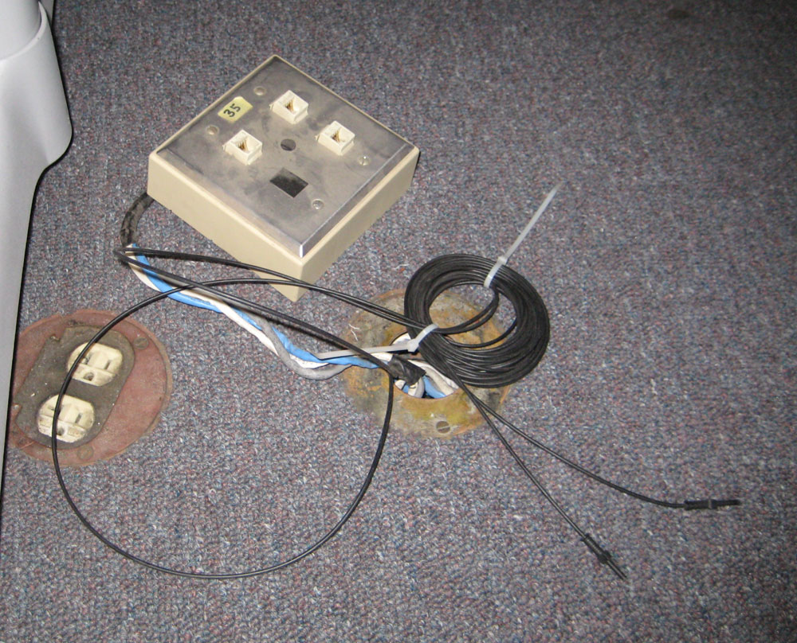
2010-11

Slide 3
Humanist List
October 25, 2010
If the humanities are in trouble,
If the digital humanities now have a special potential and responsibility to represent the humanities
  a. because the digital humanities are affecting an ever larger arc of the humanities,
  b. because the (modest) ability of the digital humanities to gain funding shows that they have the potential to seem relevant to administrators, government agencies, and possibly even legislators who otherwise have already dismissed the humanities as yesterday's news,

Slide 4
Humanist List
October 25, 2010
  c. because the digital humanities contribute to the advancement and deployment of technologies that link the humanities with other disciplines (including some STEM fields that need the participation of humanists to pursue interdisciplinary grants) [i.e., the digital humanities have true interdisciplinary potential],
  d. and because the digital humanities have the means to communicate quickly and directly to the public in ways that short-circuit the traditional, ponderous levers of university and governmental action,
  3. Then the natural course of action for interested members of the Humanist list at this extraordinary time is to start a site that, without necessarily engaging in direct political advocacy, imitates the CPSR, APC, IGC, and so on to [ . . . ]

Slide 5
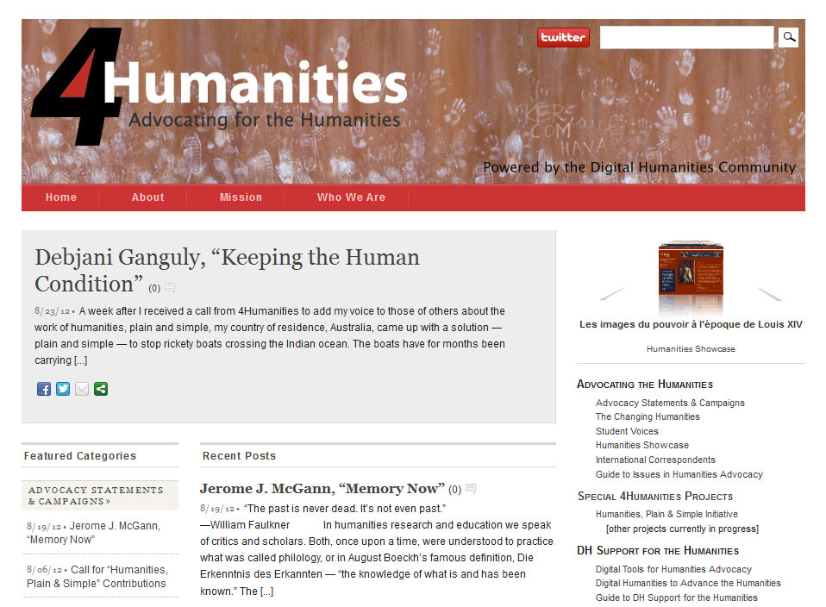
4Humanities.org

Slide 6
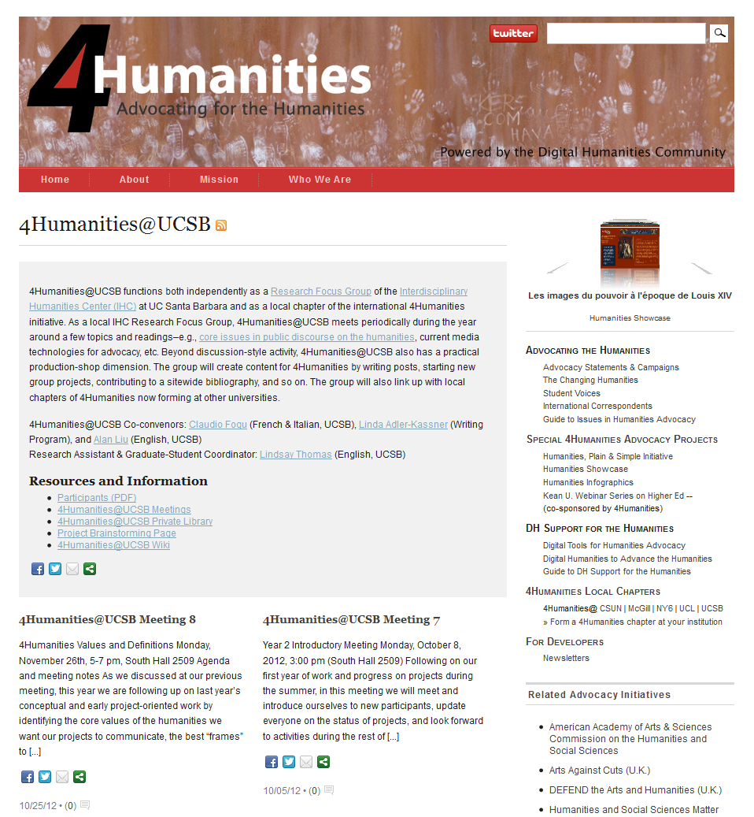
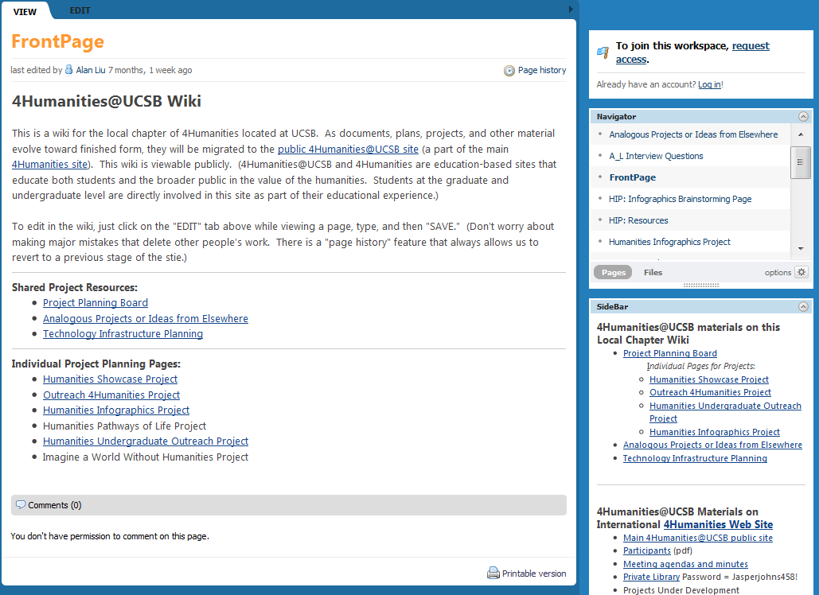
4Humanities@ CSUN | McGill | NY6 | USN | UCL | UCSB
Local Chapters
Local chapters to date:
4Humanities@UCSB, @CSUN, @McGill, @UCL, @USN, @NY6
(Colgate U, Hamilton C, Hobart & William Smith C, Skidmore C., St. Lawrence U., Union C)

Slide 7
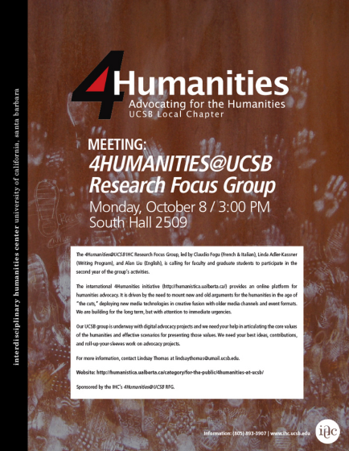
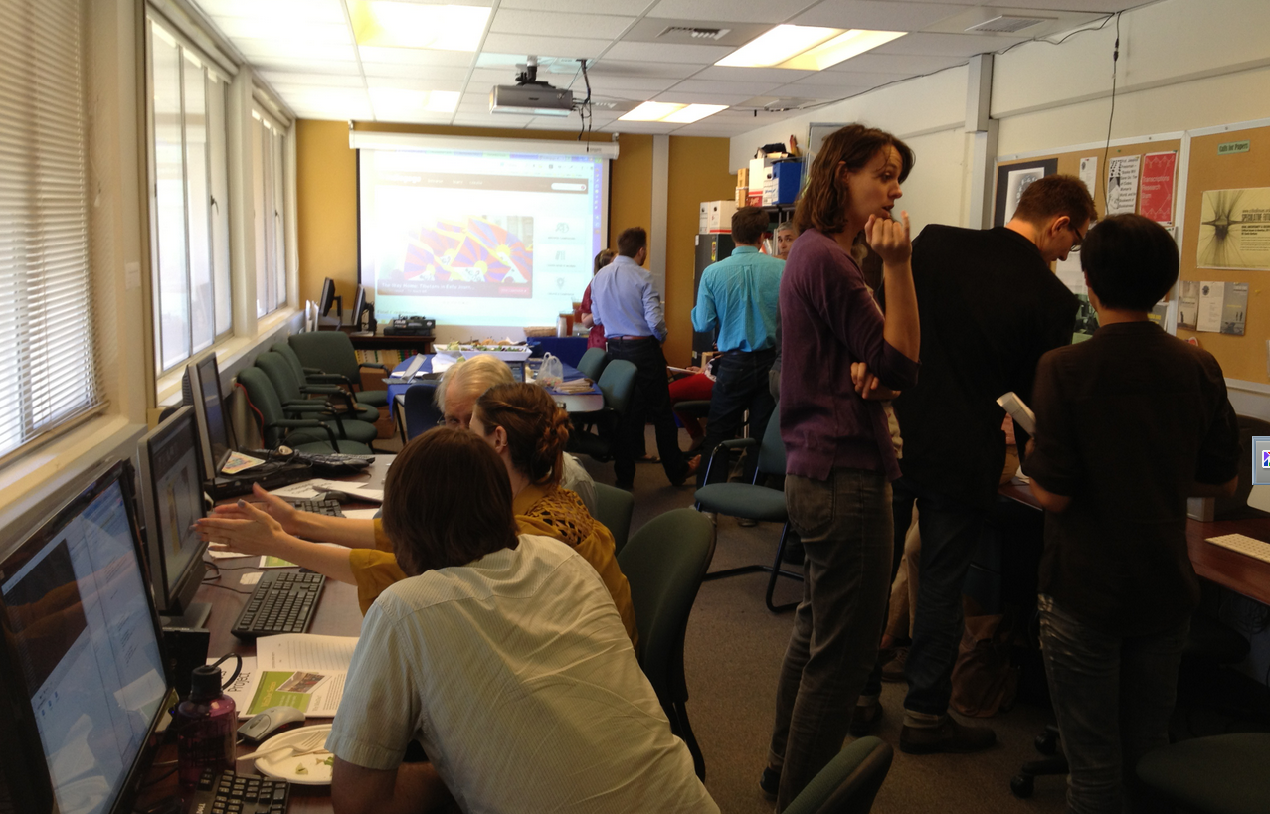
4Humanities@ CSUN | McGill | NY6 | USN | UCL | UCSB
Local Chapters
4Hum@UCSB and 4Hum@CSUN charrette, April 26, 2013

Slide 8
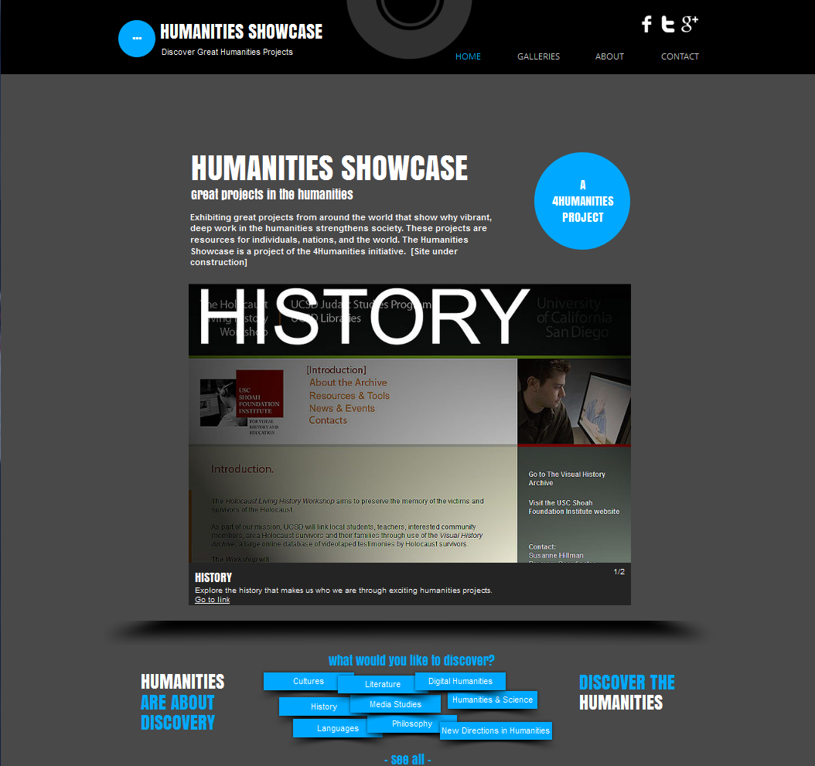
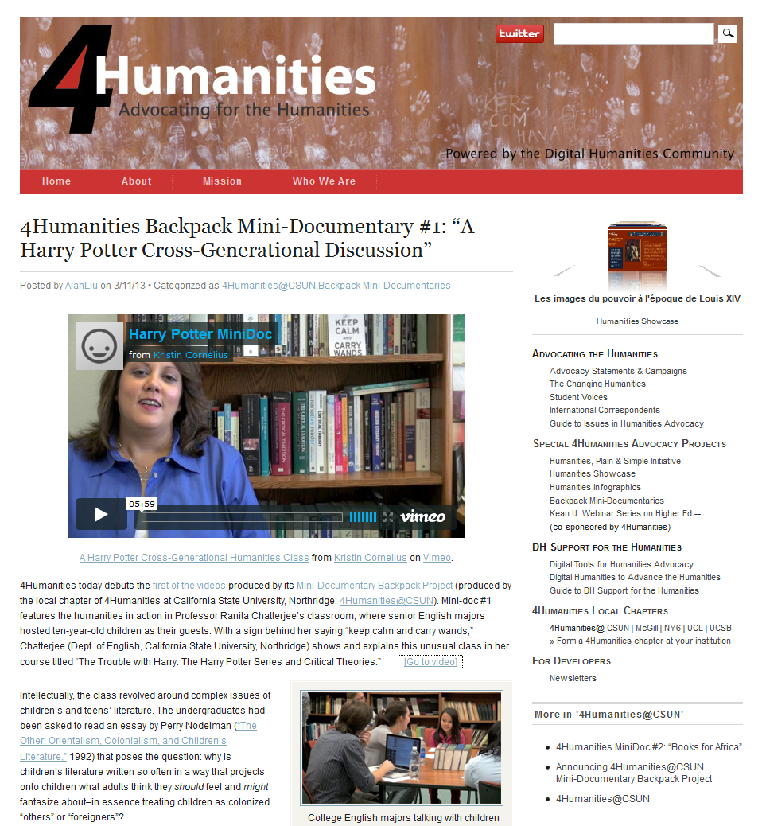
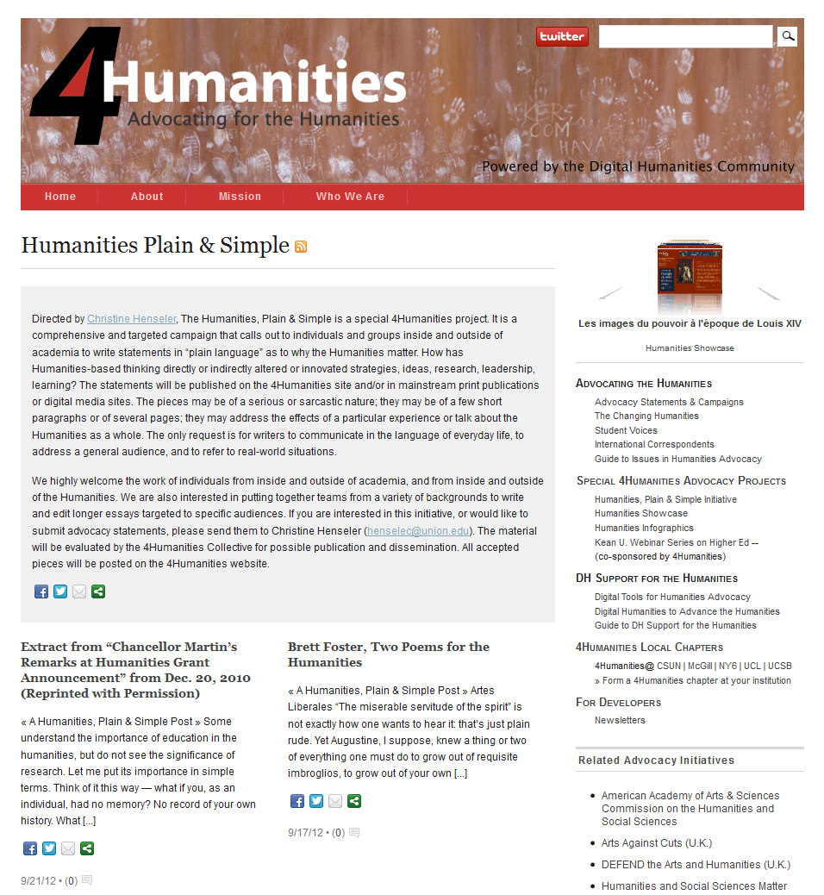
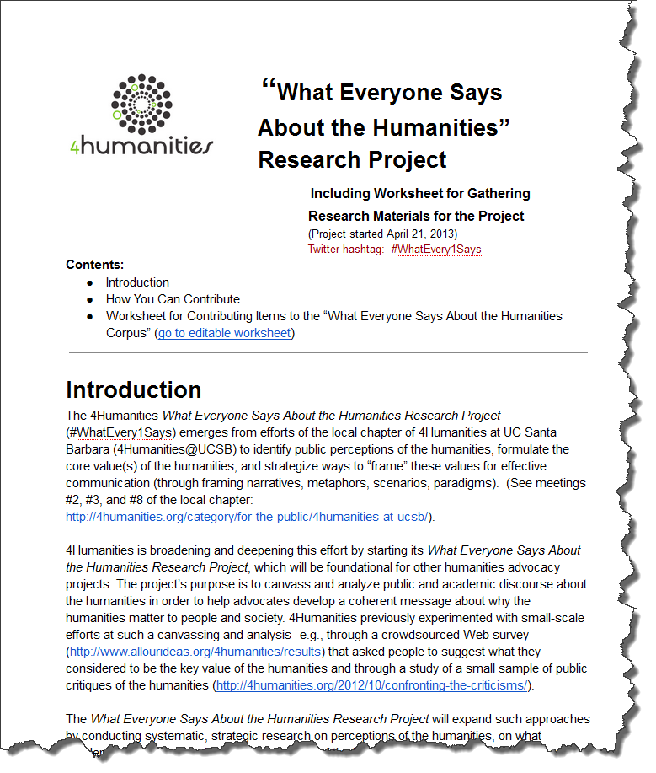
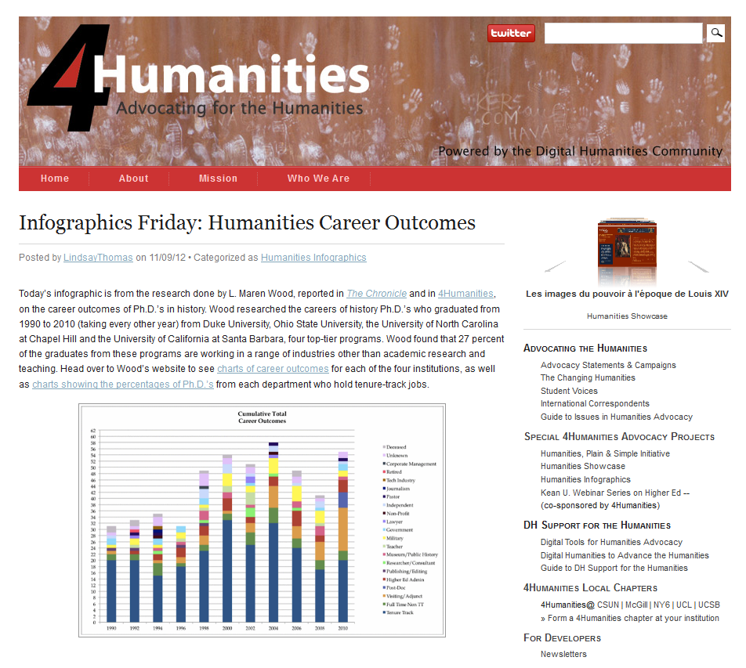
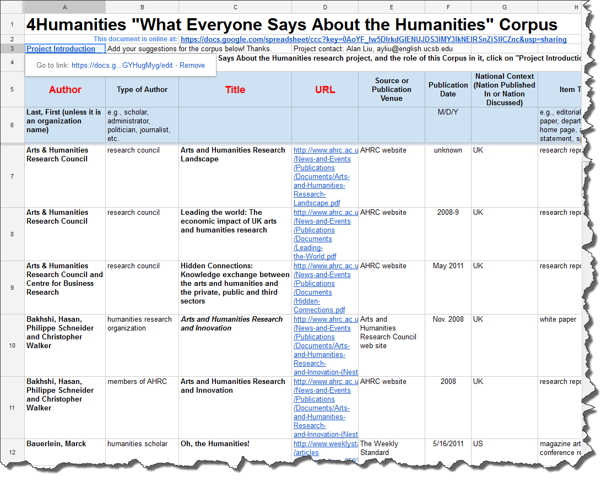
Projects
Humanities Showcase
Humanities Plain & Simple
4Humanities Backpack Mini-Documentary Videos
WhatEvery1Says
Humanities Infographics

Slide 9
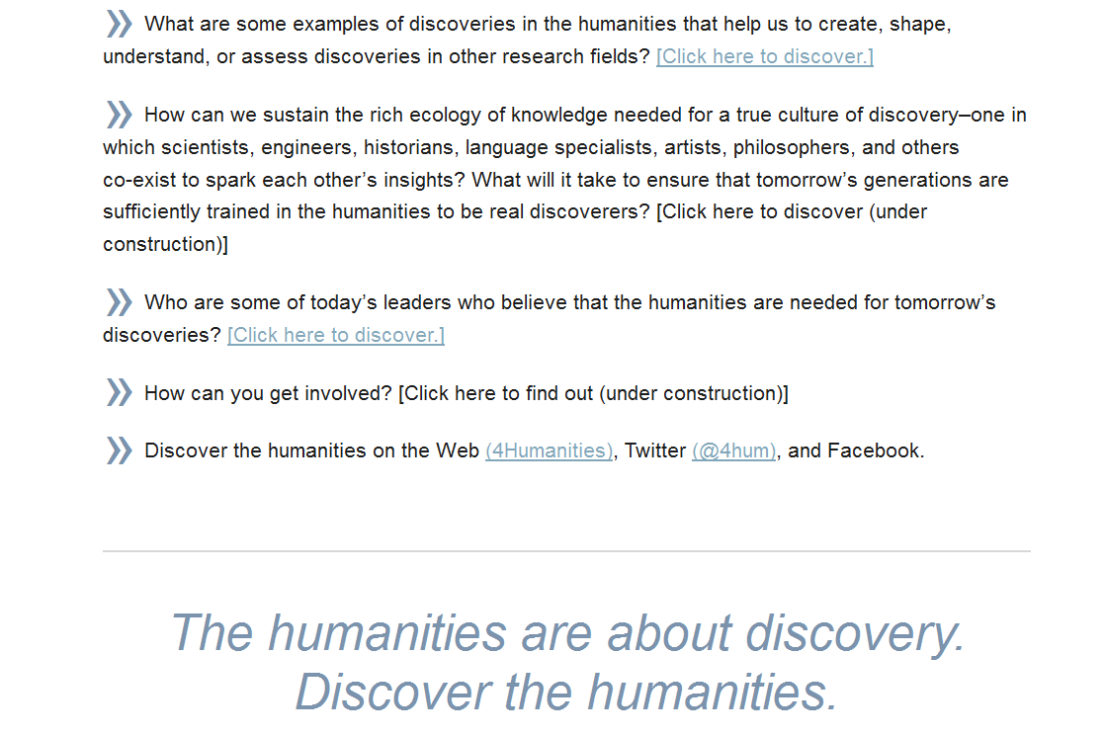
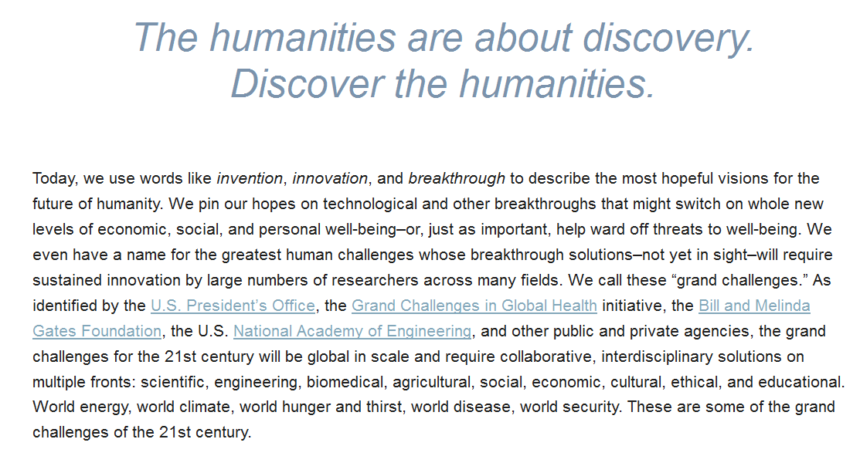
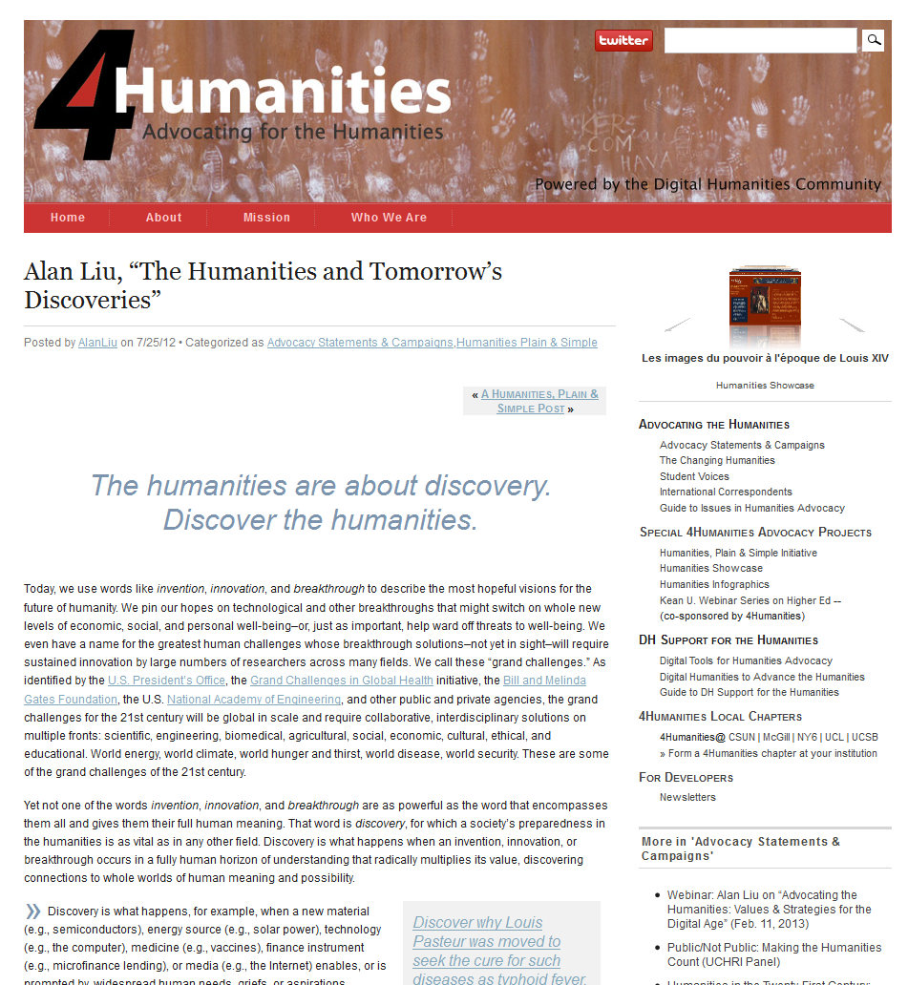
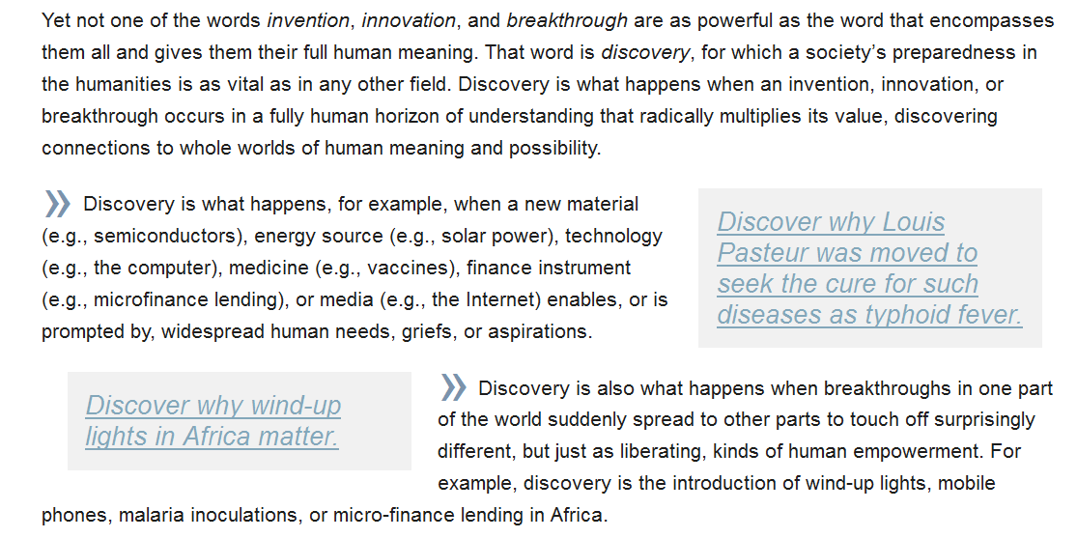
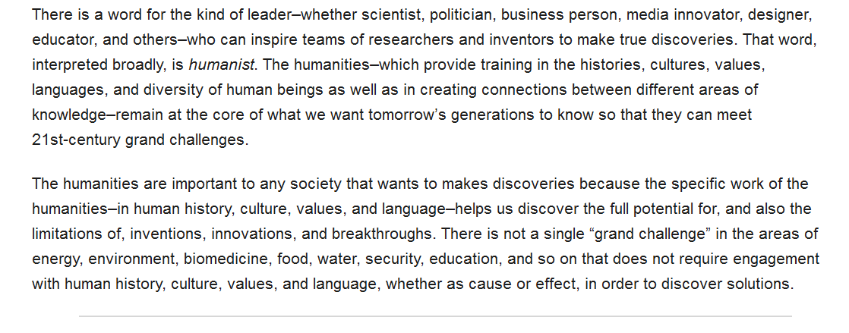
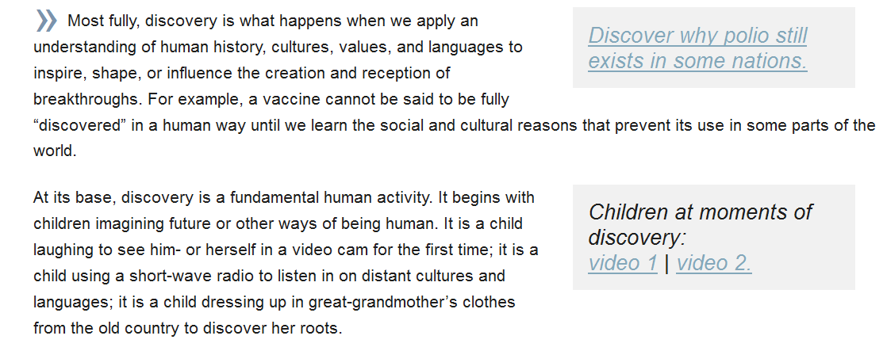
Alan Liu, “The Humanities & Tomorrow’s Discoveries”
4humanities.org/2012/07/alan-liu-the-humanities-and-tomorrows-discoveries/

Slide 10
Strategic Principles of Humanities Advocacy
Foundational Principles
Core Message
Advocacy Media Design

Slide 11
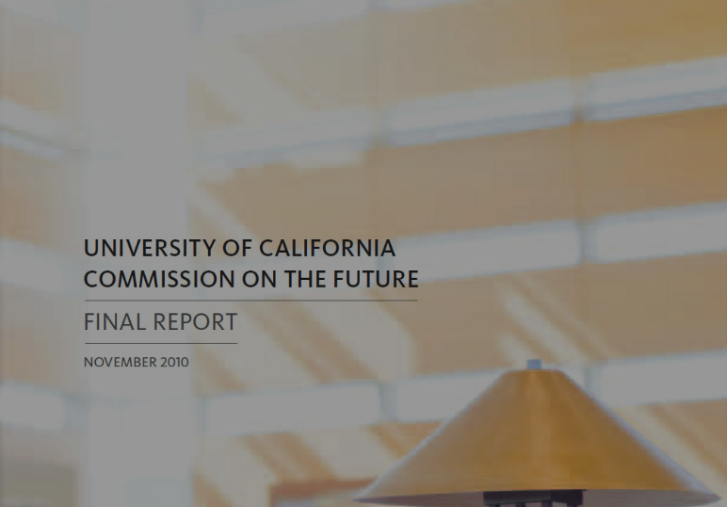
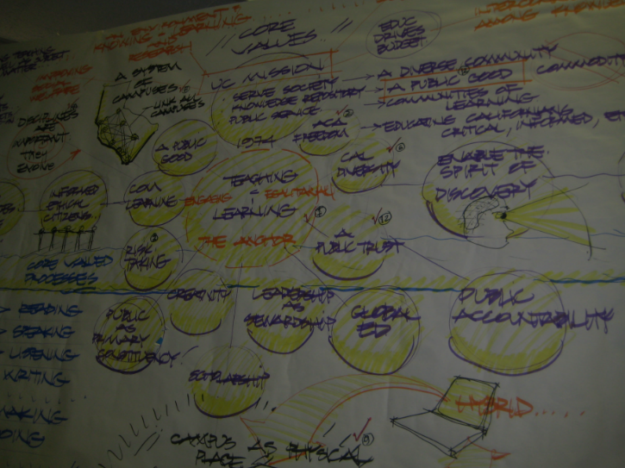
Strategic Principles of Humanities Advocacy
1. Foundational Principles
Humanities advocacy should be long-term and structural.
It should be both global and local.
It should be inclusive about what counts as "humanities."
“Uses of the University 2050” Charrette
Feb. 23-26, 2012

Slide 12

Strategic Principles of Humanities Advocacy
2. Core Message
Basic Research in the Humanities
1. The discovery, preservation, and communication of the historical and present record of human society.
2. The invention of methods for studying and interpreting that record.
3. The investigation and preservation of the languages and linguistic skills increasingly needed in a global age.
4. Experimentation in the creative arts with a wide range of social and cultural experience.
5. The new exploration of combined scientific-humanistic/artistic approaches (e.g., neuro-cognitive approaches to literature).
6. The investigation of all the above within a serious and expansive horizon of ethical reflection.
Values
  Focus groups to assess paradigmatic humanities projects
  Crowdsourcing humanities value definitions – e.g.,
    www.allourideas.org/4humanities/results
  Text-mining of humanities pro / con statements – e.g.,
    4Humanities “Confronting the Critics: A Survey of Attacks on the Humanities” humanistica.ualberta.ca/2012/10/confronting-the-criticisms
    4 Humanities WhatEvery1Says Project

Slide 13

Strategic Principles of Humanities Advocacy
“The humanities remind us where we have been and help us envision where we are going. Emphasizing critical perspective and imaginative response, the humanities— including the study of languages, literature, history, film, civics, philosophy, religion, and the arts—foster creativity, appreciation of our commonalities and our differences, and knowledge of all kinds.”
“The humanities and social sciences provide an intellectual framework and context for understanding and thriving in a changing world. When we study these subjects, we learn not only what but how and why.”
“The ability to adapt and thrive in a changing world is based not only on instruction for specific jobs of today but also on the development of professional flexibility and long-term qualities of mind: inquisitiveness, perceptiveness, the ability to put a received idea to a new purpose, and the capacity to share and build ideas with others.“
“The humanities and social sciences teach us about ourselves and others. They enable us to participate in a global economy that requires understanding of diverse culturesand sensitivity to different perspectives. And they make it possible for people around the world to work together to address issues such as environmental sustainability and global health challenges.”
2. Core Message
Basic Research in the Humanities
1. The discovery, preservation, and communication of the historical and present record of human society.
2. The invention of methods for studying and interpreting that record.
3. The investigation and preservation of the languages and linguistic skills increasingly needed in a global age.
4. Experimentation in the creative arts with a wide range of social and cultural experience.
5. The new exploration of combined scientific-humanistic/artistic approaches (e.g., neuro-cognitive approaches to literature).
6. The investigation of all the above within a serious and expansive horizon of ethical reflection.
Humanities advocacy message should emerge from values.
  Some Methods for Assessing Values
  Focus groups to assess paradigmatic humanities projects
  Crowdsourcing humanities value definitions – e.g.,
    www.allourideas.org/4humanities/results
  Text-mining of humanities pro / con statements – e.g.,
    4Humanities “Confronting the Critics: A Survey of Attacks on the Humanities” humanistica.ualberta.ca/2012/10/confronting-the-criticisms
    4 Humanities WhatEvery1Says Project
American Academy of Arts & Sciences --
Commission on the Humanities & Social Sciences
Report to the U.S. Congress, June 2013

Slide 14
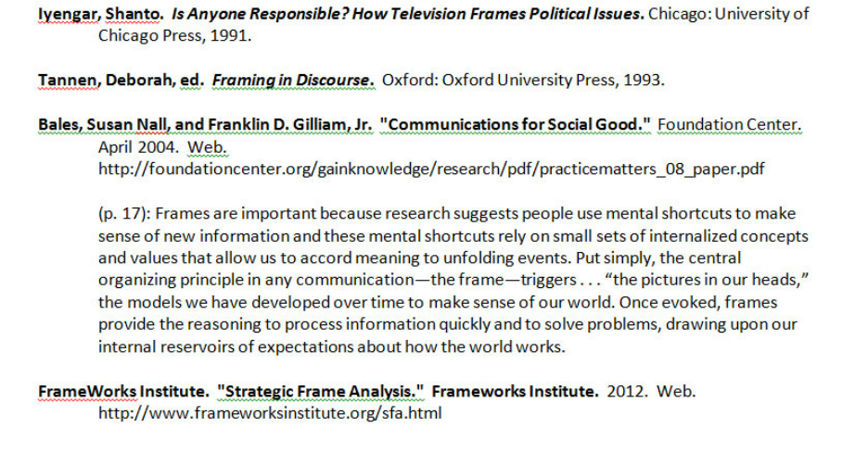
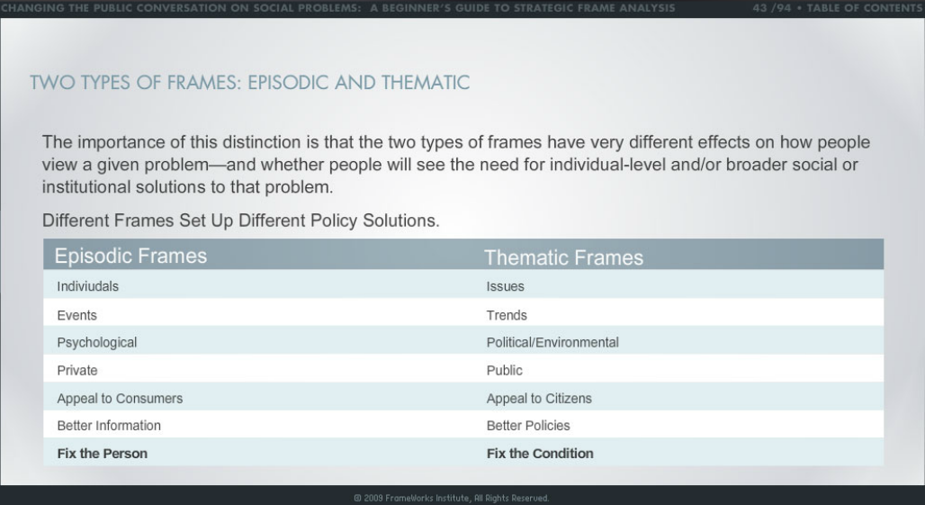
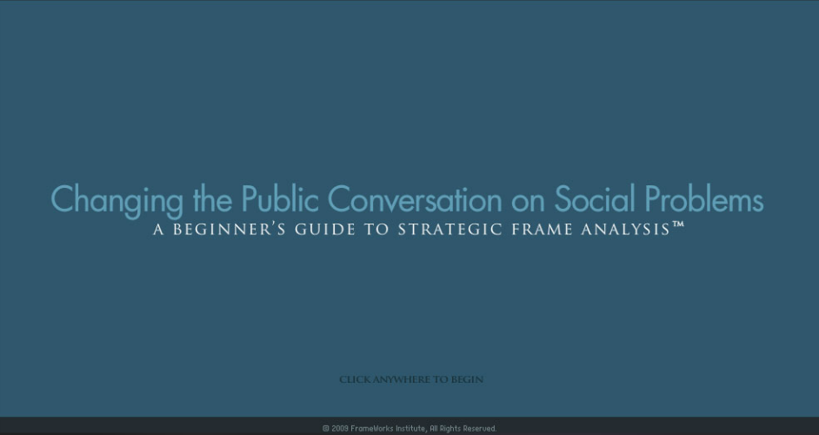
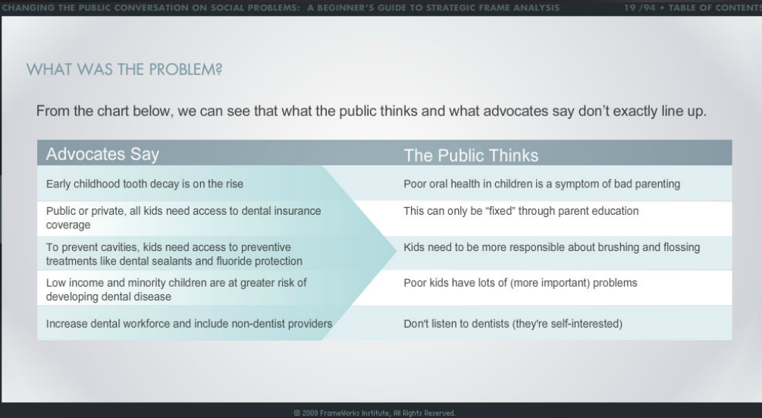
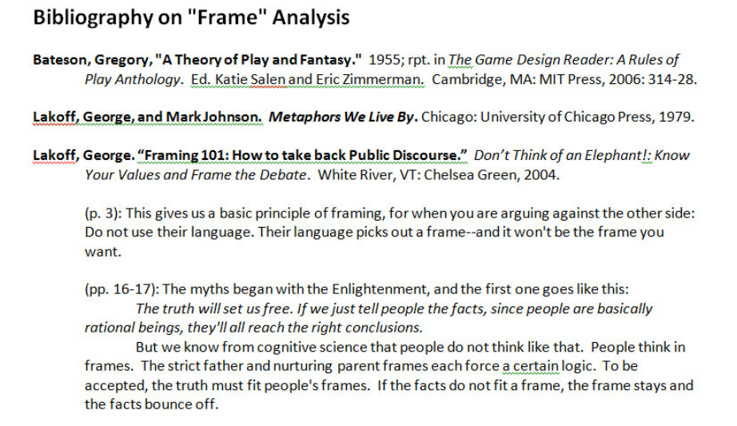
Strategic Principles of Humanities Advocacy
“The humanities remind us where we have been and help us envision where we are going. Emphasizing critical perspective and imaginative response, the humanities— including the study of languages, literature, history, film, civics, philosophy, religion, and the arts—foster creativity, appreciation of our commonalities and our differences, and knowledge of all kinds.”
“The humanities and social sciences provide an intellectual framework and context for understanding and thriving in a changing world. When we study these subjects, we learn not only what but how and why.”
“The ability to adapt and thrive in a changing world is based not only on instruction for specific jobs of today but also on the development of professional flexibility and long-term qualities of mind: inquisitiveness, perceptiveness, the ability to put a received idea to a new purpose, and the capacity to share and build ideas with others.“
“The humanities and social sciences teach us about ourselves and others. They enable us to participate in a global economy that requires understanding of diverse culturesand sensitivity to different perspectives. And they make it possible for people around the world to work together to address issues such as environmental sustainability and global health challenges.”
2. Core Message
Values
“Frames”
American Academy of Arts & Sciences --
Commission on the Humanities & Social Sciences
Report to the U.S. Congress, June 2013
Strategic Frame Analysis
(developed by sfa.frameworksinstitute.org & UCLA Center for Communications & Community)

Slide 15

Strategic Principles of Humanities Advocacy
3. Advocacy Media Design
Humanities advocacy should be designed around at least one media flow path.
Core Message
Spokesperson
Media Channel
Media Genre
Audience
Communication Design
Optimally, humanities advocacy should create plural, flexible media flow paths emerging organically from scholarly work (“media pyramids”).
Humanities advocacy should be optimized for the digital age.

Slide 16
Strategic Principles of Humanities Advocacy
3. Advocacy Media Design
Core Message
Spokesperson
Media Genre
Media Channel
Audiences
Communication Design

Slide 17
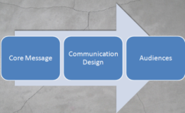
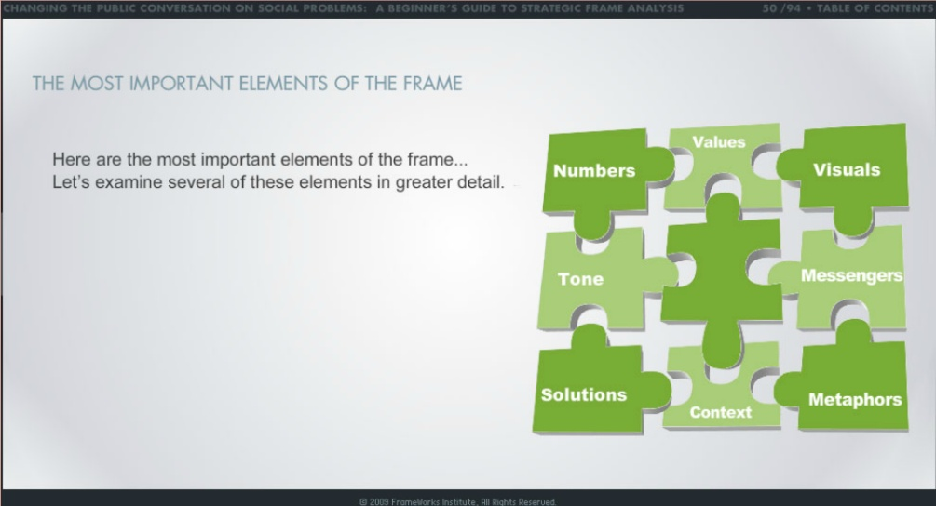
Strategic Principles of Humanities Advocacy
3. Advocacy Media Design
Core Message
Values
Frames
  Stories, Metaphors
  Visuals
  Statistics, Testimony,
  Examples
  Simplifying Slogans
Focal Issues
Action Scenarios
Solutions

Slide 18
Strategic Principles of Humanities Advocacy
3. Advocacy Media Design
Communication Design
Spokespersons Media Channels Forms/Genres
Students
Parents
Scientists
Politicians
Film or media people
Business leaders
Technology leaders
Authors
Musicians
Religious leaders
University leaders
Humanities scholars
People from elsewhere
in the world
Print
Radio
TV
Email
Web Sites
Blogs
PodCasts
YouTube
Social Media (Facebook,
Twitter)
Mobile Media
(phones, tablets)
Op-Ed, Essay, Ad,
Poster, Brochure.
Interview, Testimonial
Documentary,
Map, Infographic,
Fiction, Music,
Cartoon,
Petition, Open letter,
Funding campaign,
Celebratory event,
Boycott, March,
Hack attack

Slide 19

Strategic Principles of Humanities Advocacy
3. Advocacy Media Design
Audiences
Journalists
Politicians
Community leaders
Administrators
Funding Agencies
Parents
School teachers
Students
Fellow Academics
Voters
Global audience

Slide 20
Strategic Principles of Humanities Advocacy
3. Advocacy Media Design
3. Public Engagement Design
Core Message
Spokesperson
Media Genre
Media Channel
Audiences
Communication Design

Slide 21

IT for Advocacy & Public Engagement
Key Concepts of Online Activism
E-mobilizations / E-tactics / E-movements
“Supersize versus theory 2.0” views of online activism
“A new digital repertoire of contention”
“Leveraging low costs” & “power law” dynamics
“Organizing without organizations”
(social movement organizations vs. non-SMO sites)
Coordination vs. co-presence
(“acting together without being together”)
“Lone-wolf,” “small team,” &“distributed” organizing
“Five-minute activism” (and “flash activism”)
(MIT Press, 2011)

Slide 22
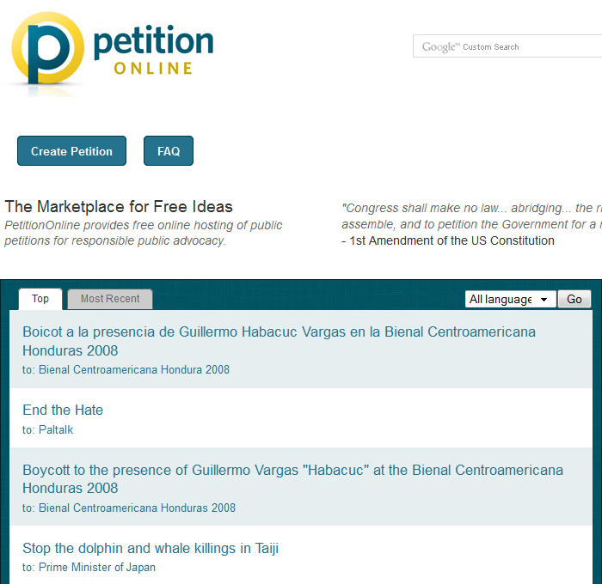
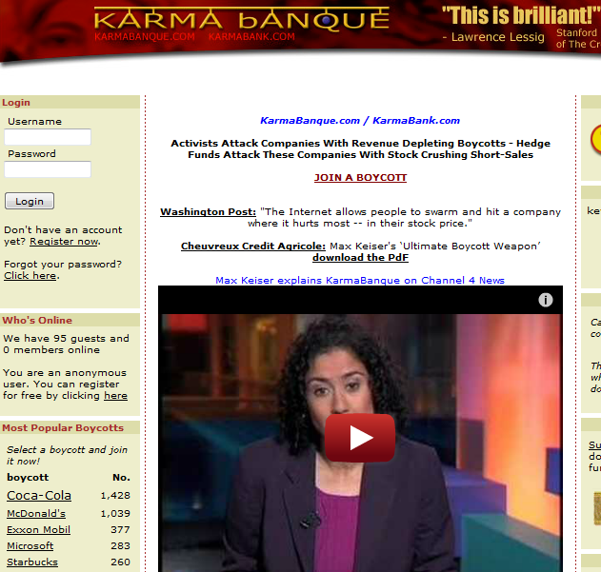
IT for Advocacy & Public Engagement
Examples of E-tactics Platforms & Tools:

Slide 23

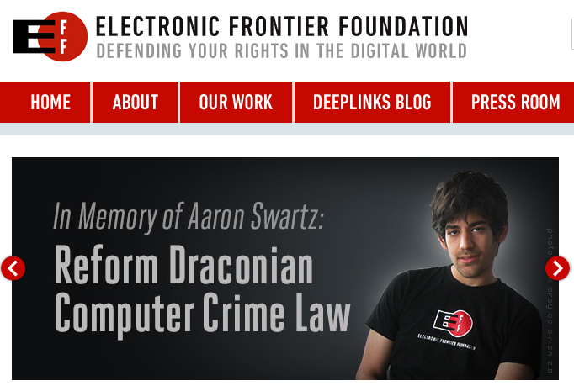

IT for Advocacy & Public Engagement
Early Activist IT Sites:

Slide 24





IT for Advocacy & Public Engagement
Recent Activist Sites Using IT:

Slide 25
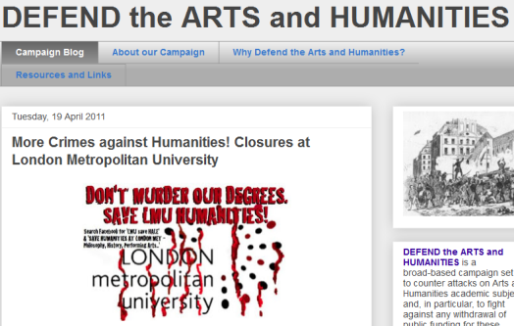



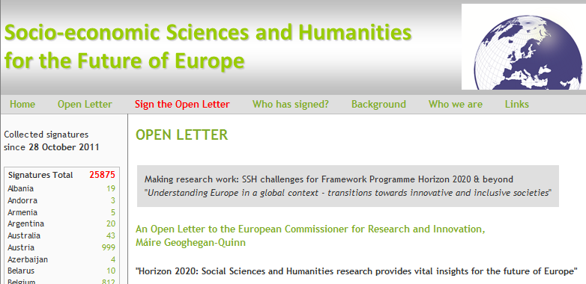
IT for Advocacy & Public Engagement
Examples of Humanities & Arts Advocacy Sites:

Slide 26
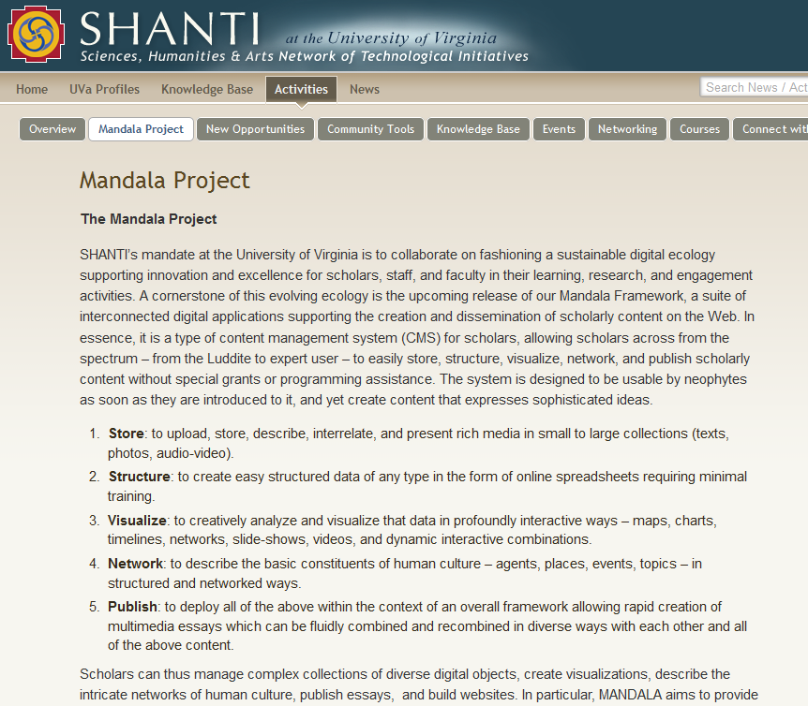
Off-the-Shelf IT for Advocacy & Public Engagement [examples]
Publication & Exhibition Platforms
Content Management Systems
Wordpress
Drupal
Joomla
MediaWiki
PBWiki
Radiant
Open Journal Systems
CommentPress
Omeka
Neatline
Scalar
Wix
YouTube, Podcasts, etc.
IT for Communicating Advocacy
CMS systems
Publication & exhibition systems
Social media
Social action sites
Social Media
Blogs
Facebook
Twitter
Social Action Sites
Petition tools
Boycott organizing tools
Polling & Survey tools

Slide 27
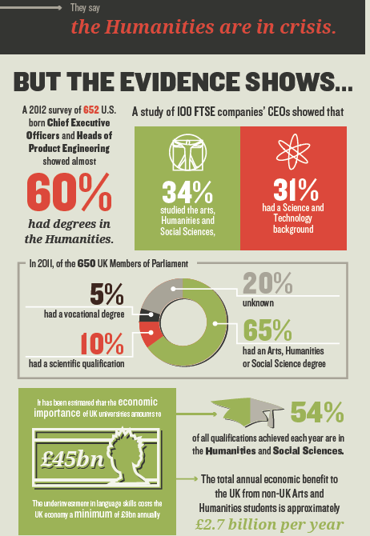
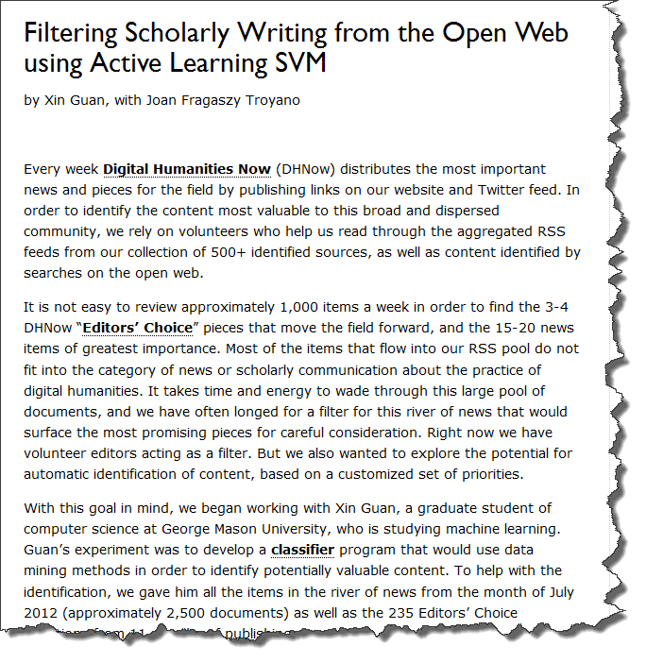
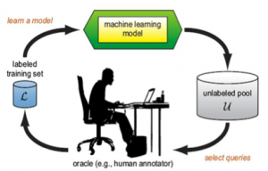
Off-the-Shelf IT for Advocacy & Public Engagement [examples]
Humanities Datasets
“Pipes”
Humanities-related repositories, datasets, & linked data--e.g.:
Europeana
DLPA
HuNI
DPpedia
YAGO
SNAC
Corpora of public discourse about humanities (WhatEvery1Says)
Humanities statistics
RSS Feed readers (e.g., Feedly)
Linked Data Browers (e.g., OpenLink Data Explorer)
API’s (e.g., DLPA API’s)
Mashup tools (e.g., Yahoo Pipes)
Scrapers (e.g., Scrapy, TheWebMiner)
Classifiers (e.g., Roy Rosenzweig Center classifer)
IT for Researching & Producing Advocacy
Humanities Datasets
“Pipes”
Datamining Tools
Visualization & infographics
Funding Platforms
Datamining Tools
Text-mining tools (e.g., TAPoR, Voyeur, Google Ngram Viewer, Jstor Data for Research)
Topic-modeling tools (e.g., Mallet suite)
Social network analysis tools (e.g. UCINET)
Bibliometric & co-citation tools (e.g., Jstor Data for Research)
Statistical tools (e.g., “R”)
Funding Platforms
Kickstarter
Indiegogo
RocketHub
GoFundMe
Razoo
Crowdrise
Visualization & Infographics
Gephi
NodeXL Network Graphs
D3.js
Many Eyes
Tableau Public

Slide 28
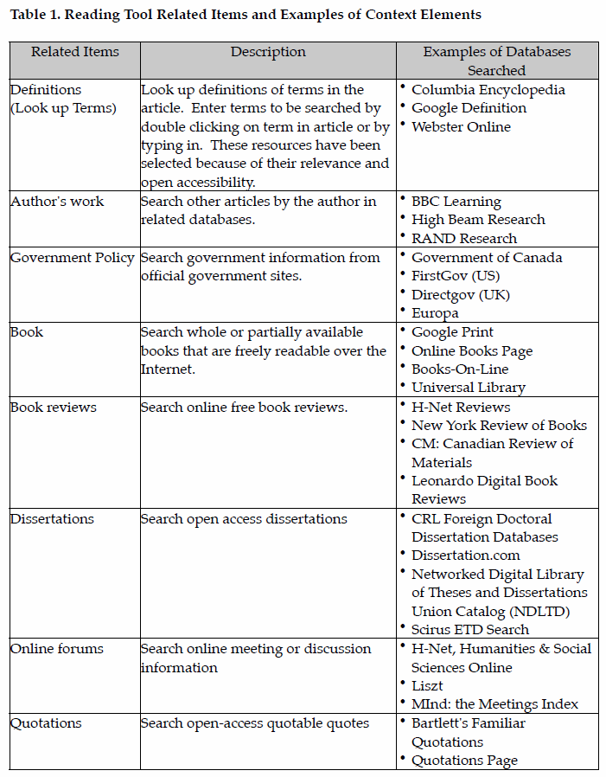
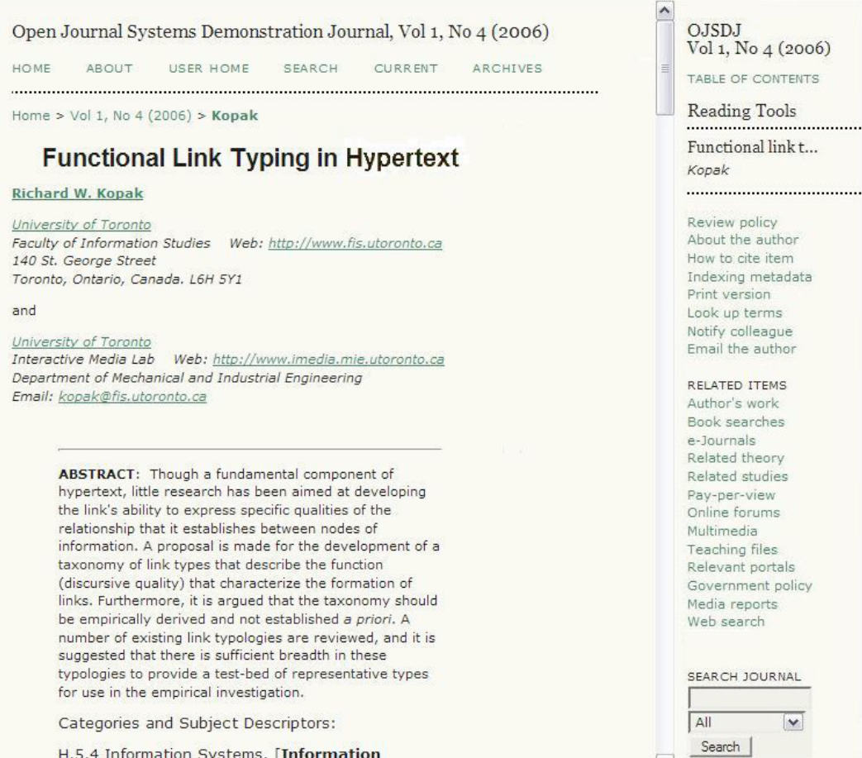
Future IT for Humanities Advocacy & Public Engagement
Open Journal Systems
“Reading Tools”

Slide 29
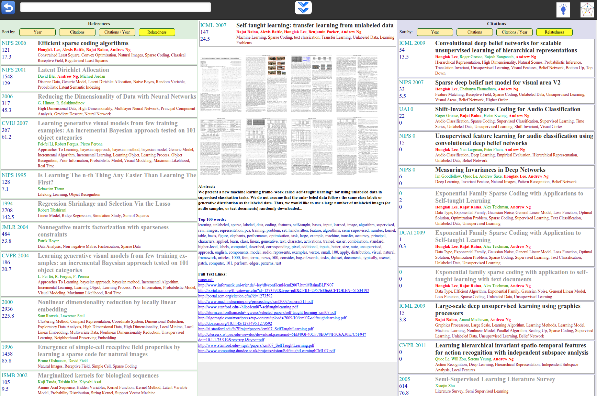
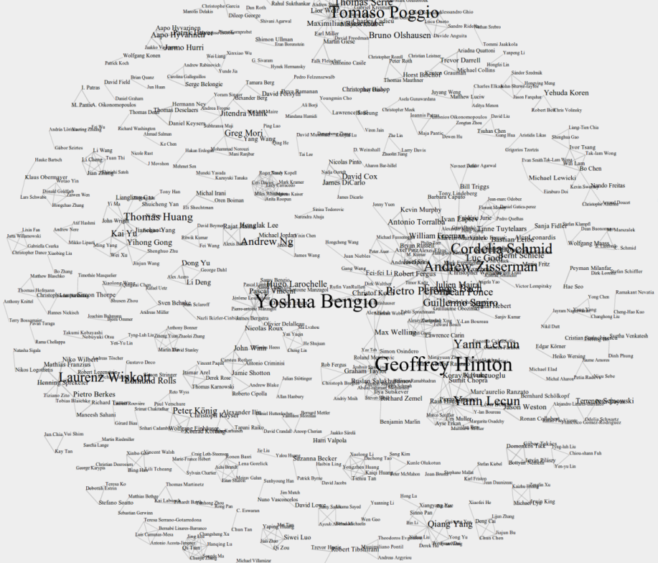
Future IT for Humanities Advocacy & Public Engagement
Research Lei
Academic Papers Management
and Discovery System
Figure 1: The main interface includes a paper, the papers it references (left), the papers that cite it (right), abstract, top words and links to full text version. The user navigates by simply clicking on papers, or using search (top).
_______________________________________________
Figure 2: Additional exploration tools. Here, a force-directed interactive layout. Each edge joins researchers who co-authored at least 2 papers

Slide 30
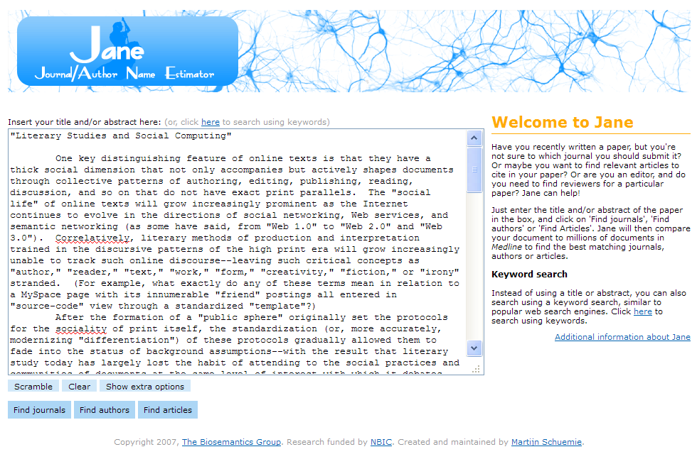
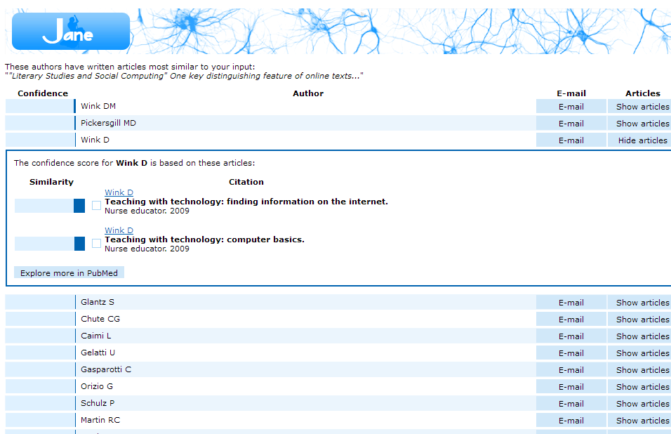
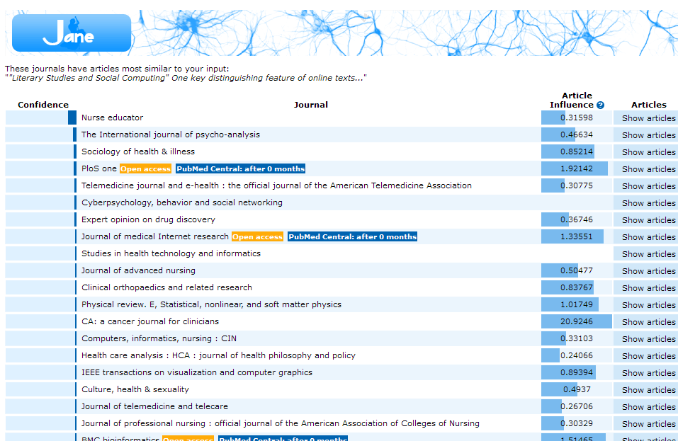
Future IT for Humanities Advocacy & Public Engagement
Jane
Journal / Author Name Estimator

Slide 31
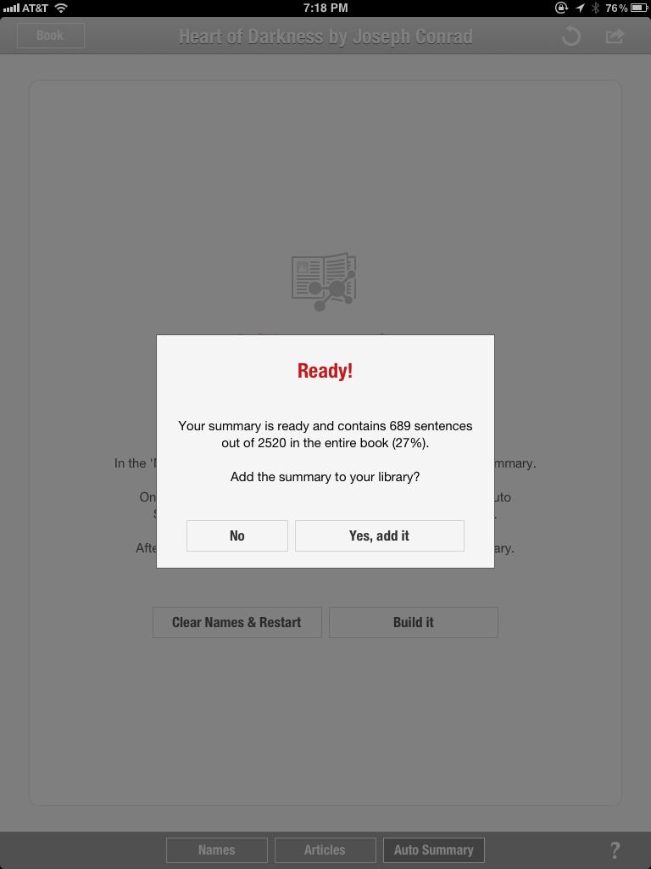
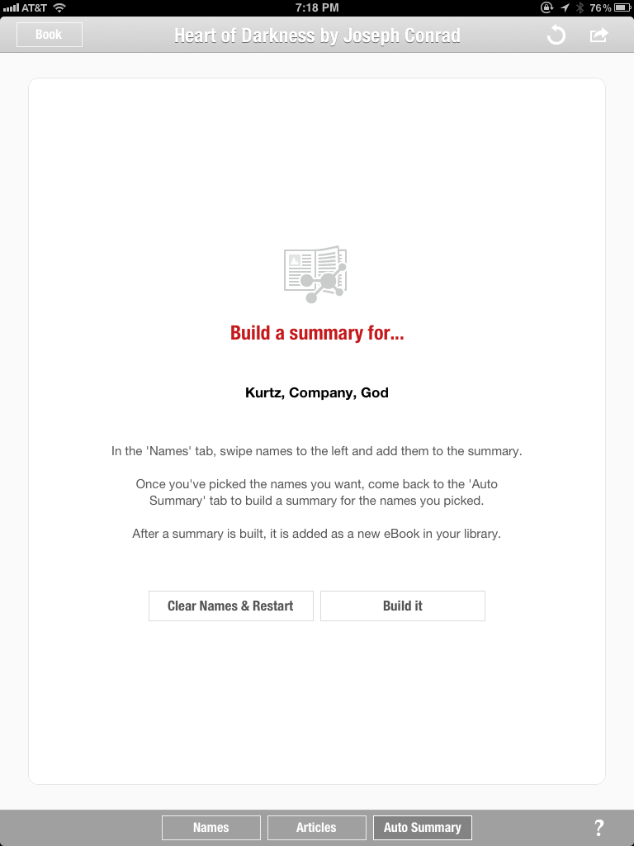
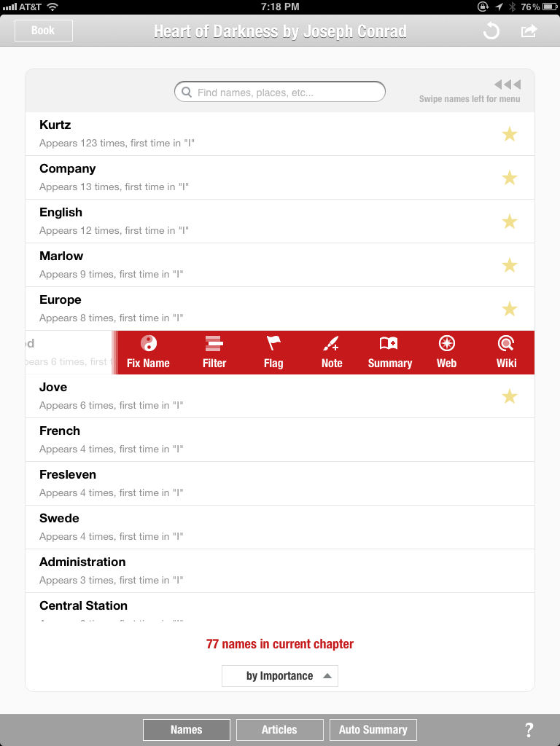
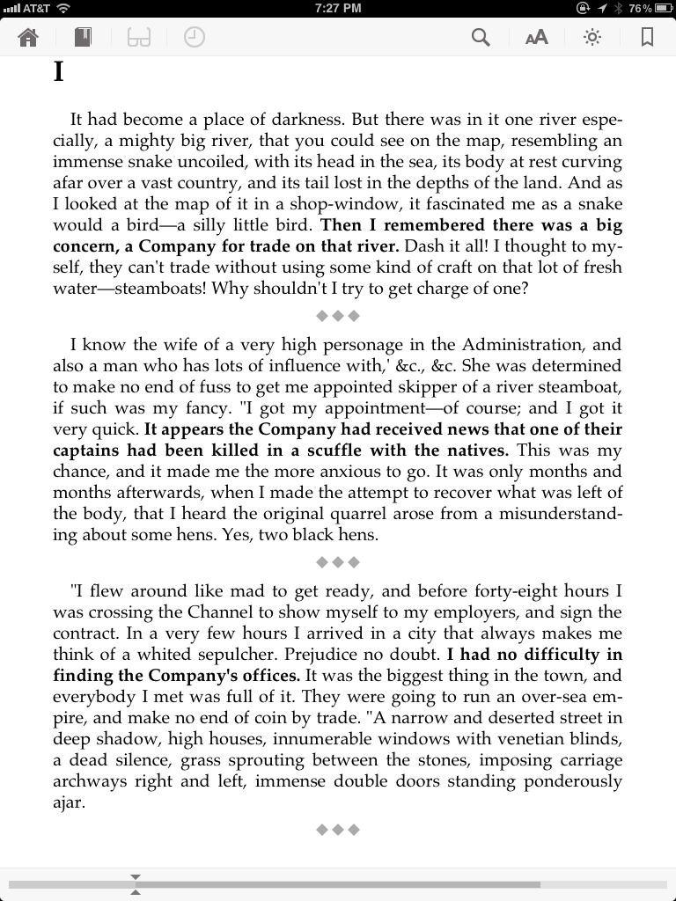
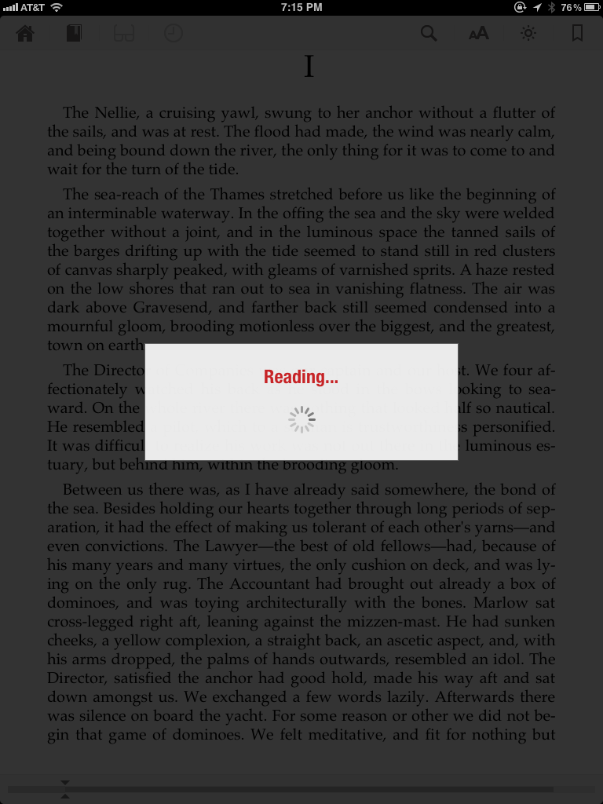
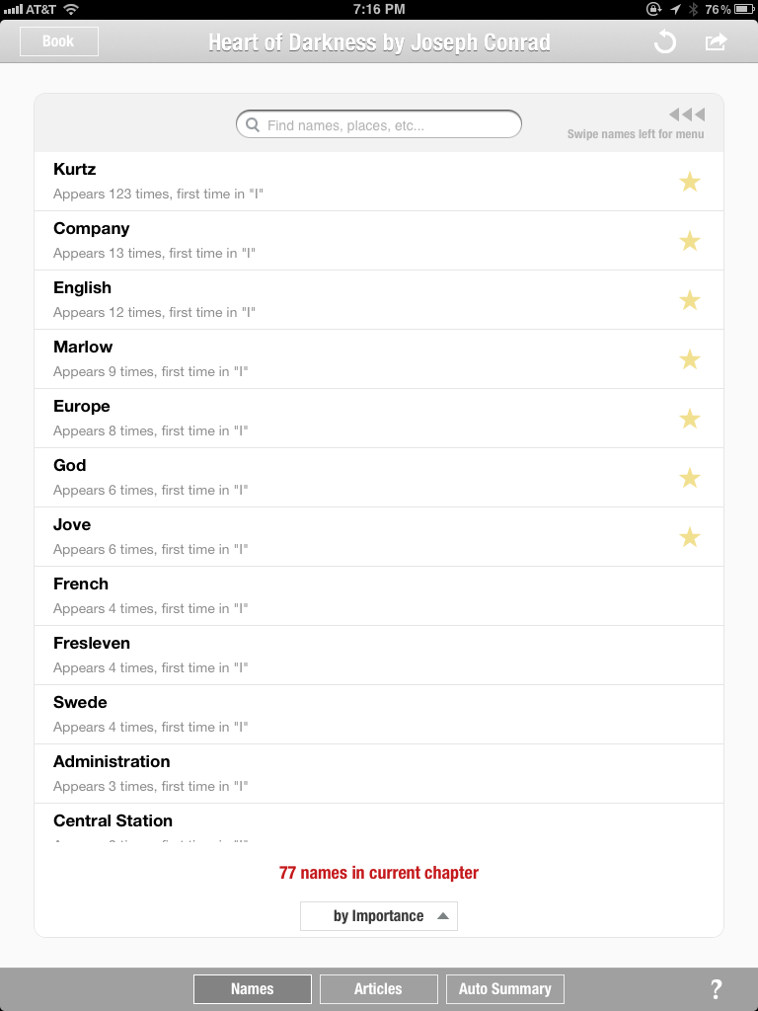
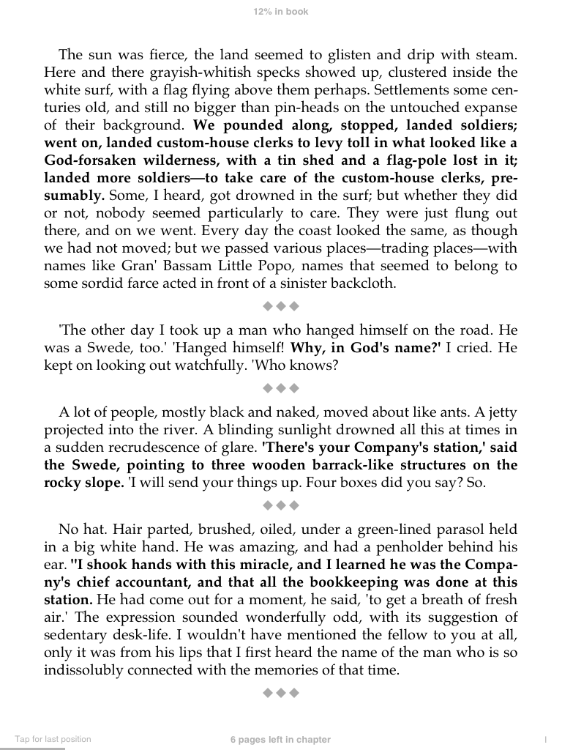

Future IT for Humanities Advocacy & Public Engagement
“Marvin” app for iPad

Slide 32

Future IT for Humanities Advocacy & Public Engagement
Computers and the Humanities
37 (2003): 455-67

Slide 33


Future IT for Humanities Advocacy & Public Engagement
PLoS Computational Biology “Topic Pages” for Wikipedia
Implemented through PLOS CB Wikimedia site as part of workflow leading to peer-reviewed topic pages published in PLOS CB that are also seed articles submitted to Wikipedia.
“PLoS Computational Biology publishes a version that is static, includes author attributions, and is indexed in PubMed. In addition, we intend to make the reviews and reviewer identities of Topic Pages available to our readership. Our hope is that the Wikipedia pages subsequently become living documents that will be updated and enhanced by the Wikipedia community.…”

Slide 34


Future IT for Humanities Advocacy & Public Engagement
JoVE (Journal of Visualized Experiments)

Slide 35

Future IT for Humanities Advocacy & Public Engagement
OpenImpact Project:
Collecting and telling stories of high-impact research as part of JISC “virtual research environment”

Slide 36

Future IT for Humanities Advocacy & Public Engagement
Normal Scholarly Work
Course Syllabi
Class Notes
Research Notes
Talks
Publications
Blog & Twitter posts
Word processors
Presentation Programs
Spreadsheets
Course management systems
Dept. or univ. web sites
Personal web sites
Social Media
Normal IT in Workflow

Slide 37
Future IT for Humanities Advocacy & Public Engagement
Machine-assisted Summaries
Matching extracts to Wikipedia “stubs”
Input from Normal Workflow
Normal Scholarly Work
Course Syllabi
Class Notes
Research Notes
Talks
Publications
Blog & Twitter posts
Word processors
Presentation Programs
Spreadsheets
Course management systems
Dept. or univ. web sites
Personal web sites
Social Media
Summary Content
Auto-generated Tweets
Auto-generated material for blogs
Normal IT in Workflow

Slide 38
Future IT for Humanities Advocacy & Public Engagement
Machine-assisted Summaries
Matching extracts to Wikipedia “stubs”
Input from Normal Workflow
Normal Scholarly Work
Course Syllabi
Class Notes
Research Notes
Talks
Publications
Blog & Twitter posts
Word processors
Presentation Programs
Spreadsheets
Course management systems
Dept. or univ. web sites
Personal web sites
Social Media
Summary Content
Auto-generated Tweets
Auto-generated material for blogs
Normal IT in Workflow
Machine-generated Context
Social network graph of related authors
Links to related material in databases
Links to related material via topic modeling

Slide 39
Future IT for Humanities Advocacy & Public Engagement
Machine-assisted Summaries
Matching extracts to Wikipedia “stubs”
Input from Normal Workflow
Normal Scholarly Work
Course Syllabi
Class Notes
Research Notes
Talks
Publications
Blog & Twitter posts
Word processors
Presentation Programs
Spreadsheets
Course management systems
Dept. or univ. web sites
Personal web sites
Social Media
Summary Content
Auto-generated Tweets
Auto-generated material for blogs
Normal IT in Workflow
Machine-generated Context
Social network graph of related authors
RSS syndication
Links to related material in databases
Machine-assisted Presentation, Dissemination, Curation
Links to related material via topic modeling
SEO & Analytics
Piped input to Dept. web sites
Submission to humanities aggregators (DPLA, 4Hum, etc.)
Submission to news media

Slide 40
Future IT for Humanities Advocacy & Public Engagement
Machine-assisted Summaries
Matching extracts to Wikipedia “stubs”
Input from Normal Workflow
Normal Scholarly Work
Course Syllabi
Class Notes
Research Notes
Talks
Publications
Blog & Twitter posts
Word processors
Presentation Programs
Spreadsheets
Course management systems
Dept. or univ. web sites
Personal web sites
Social Media
Summary Content
Auto-generated Tweets
Auto-generated material for blogs
Normal IT in Workflow
Machine-generated Context
Social network graph of related authors
RSS syndication
Links to related material in databases
Machine-assisted Presentation, Dissemination, Curation
The Human Touch
Links to related material via topic modeling
SEO & Analytics
Public engagement service roles
Piped input to Dept. web sites
Submission to humanities aggregators (DLPA, 4Hum, etc.)
Submission to news media
Human editing of machine-generated content
Department-level editing & curation

Slide 41
Humanities Scholarship & Media Pyramids
“The Human Touch”
Final human-ed. material (e.g., “Humanities & Tomorrow’s Discoveries”)
Assisted Dissemination
Formatting & content-flow to blogs, Twitter, dept. sites, etc..
Generated Context
Related links, co-citations, social graph.
Generated Content
Summaries, abstracts, excerpts, examples.
Scholarship
Normal workflow of research & teaching.

Slide 42
Connect with the Public to Make the Funding Case
“This Commission calls for increased support for humanistic and social scientific research in every field. However, the larger funding problem will not be solved by making louder requests where there is little inclination to give.
(pp. 39-40)
If scholars in the broad humanistic disciplines expect the public to be more financially supportive, they must make the case for the public value of their work much more effectively than they have in recent years.
This is not just a matter of sharpened message points to budget appropriators. Everything scholars do to connect with the broader public advances their case for support, and everything they neglect to do weakens that case. Top scholars should embrace the chance to connect with the larger community and help it feel the interest of their subjects and the power of their analyses.”
(pp. 39-40)
If scholars in the broad humanistic disciplines expect the public to be more financially supportive, they must make the case for the public value of their work much more effectively than they have in recent years.
This is not just a matter of sharpened message points to budget appropriators. Everything scholars do to connect with the broader public advances their case for support, and everything they neglect to do weakens that case. Top scholars should embrace the chance to connect with the larger community and help it feel the interest of their subjects and the power of their analyses.”
(pp. 39-40)

Slide 43
Values, Strategies, and Technologies for
Humanities Advocacy in the Digital Age
Alan Liu
Australasian Consortium of
Humanities Research Centres
Annual Meeting, July 8, 2013

